Slide 1
Data Structures/Big Data
Please turn on the silent mode of your mobile phone!
Today: some Big O, sorting and reading files.
Chulalongkorn University
School of Integrated Innovation
Fall 2023 (15 Aug)
Marko Niinimaki

Slide 2
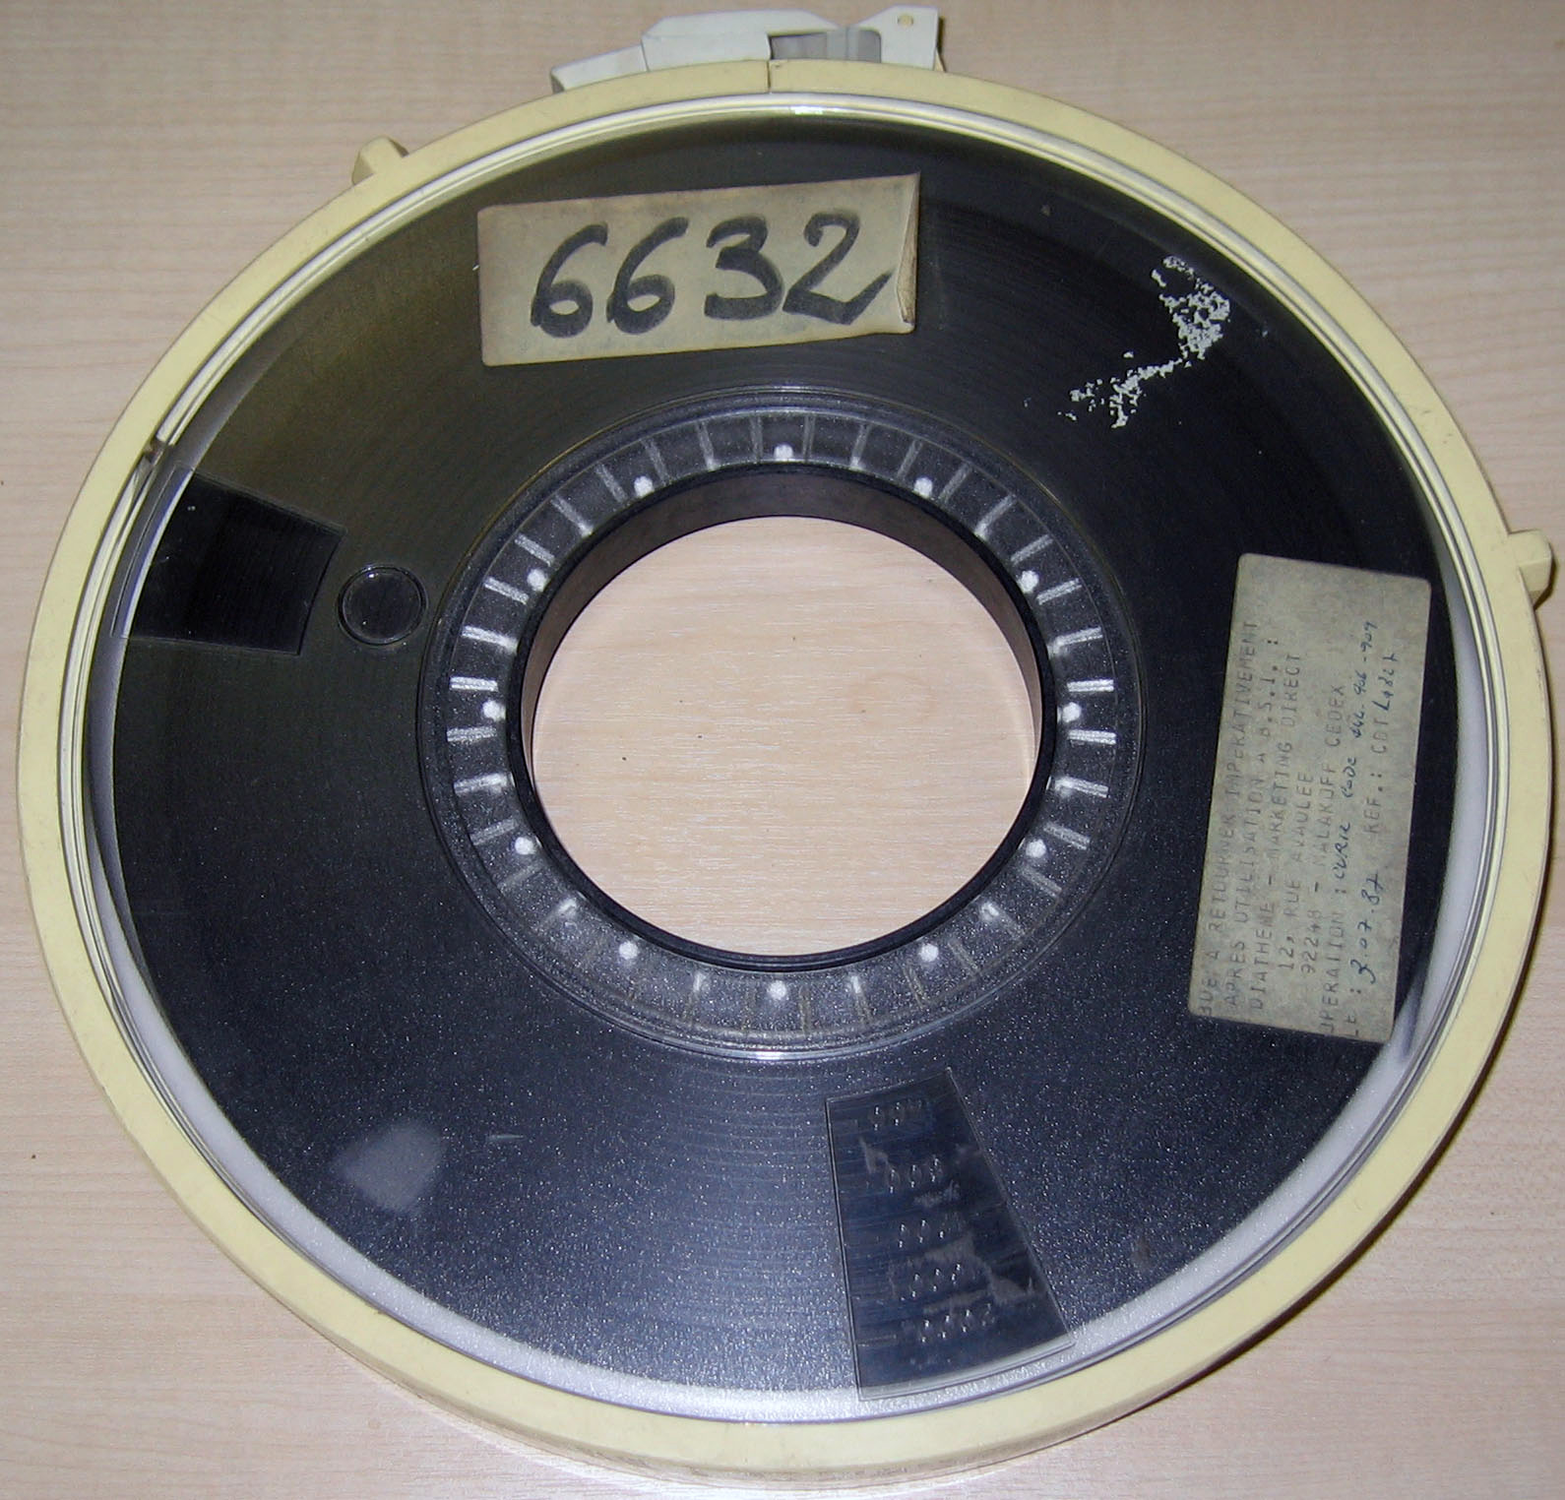
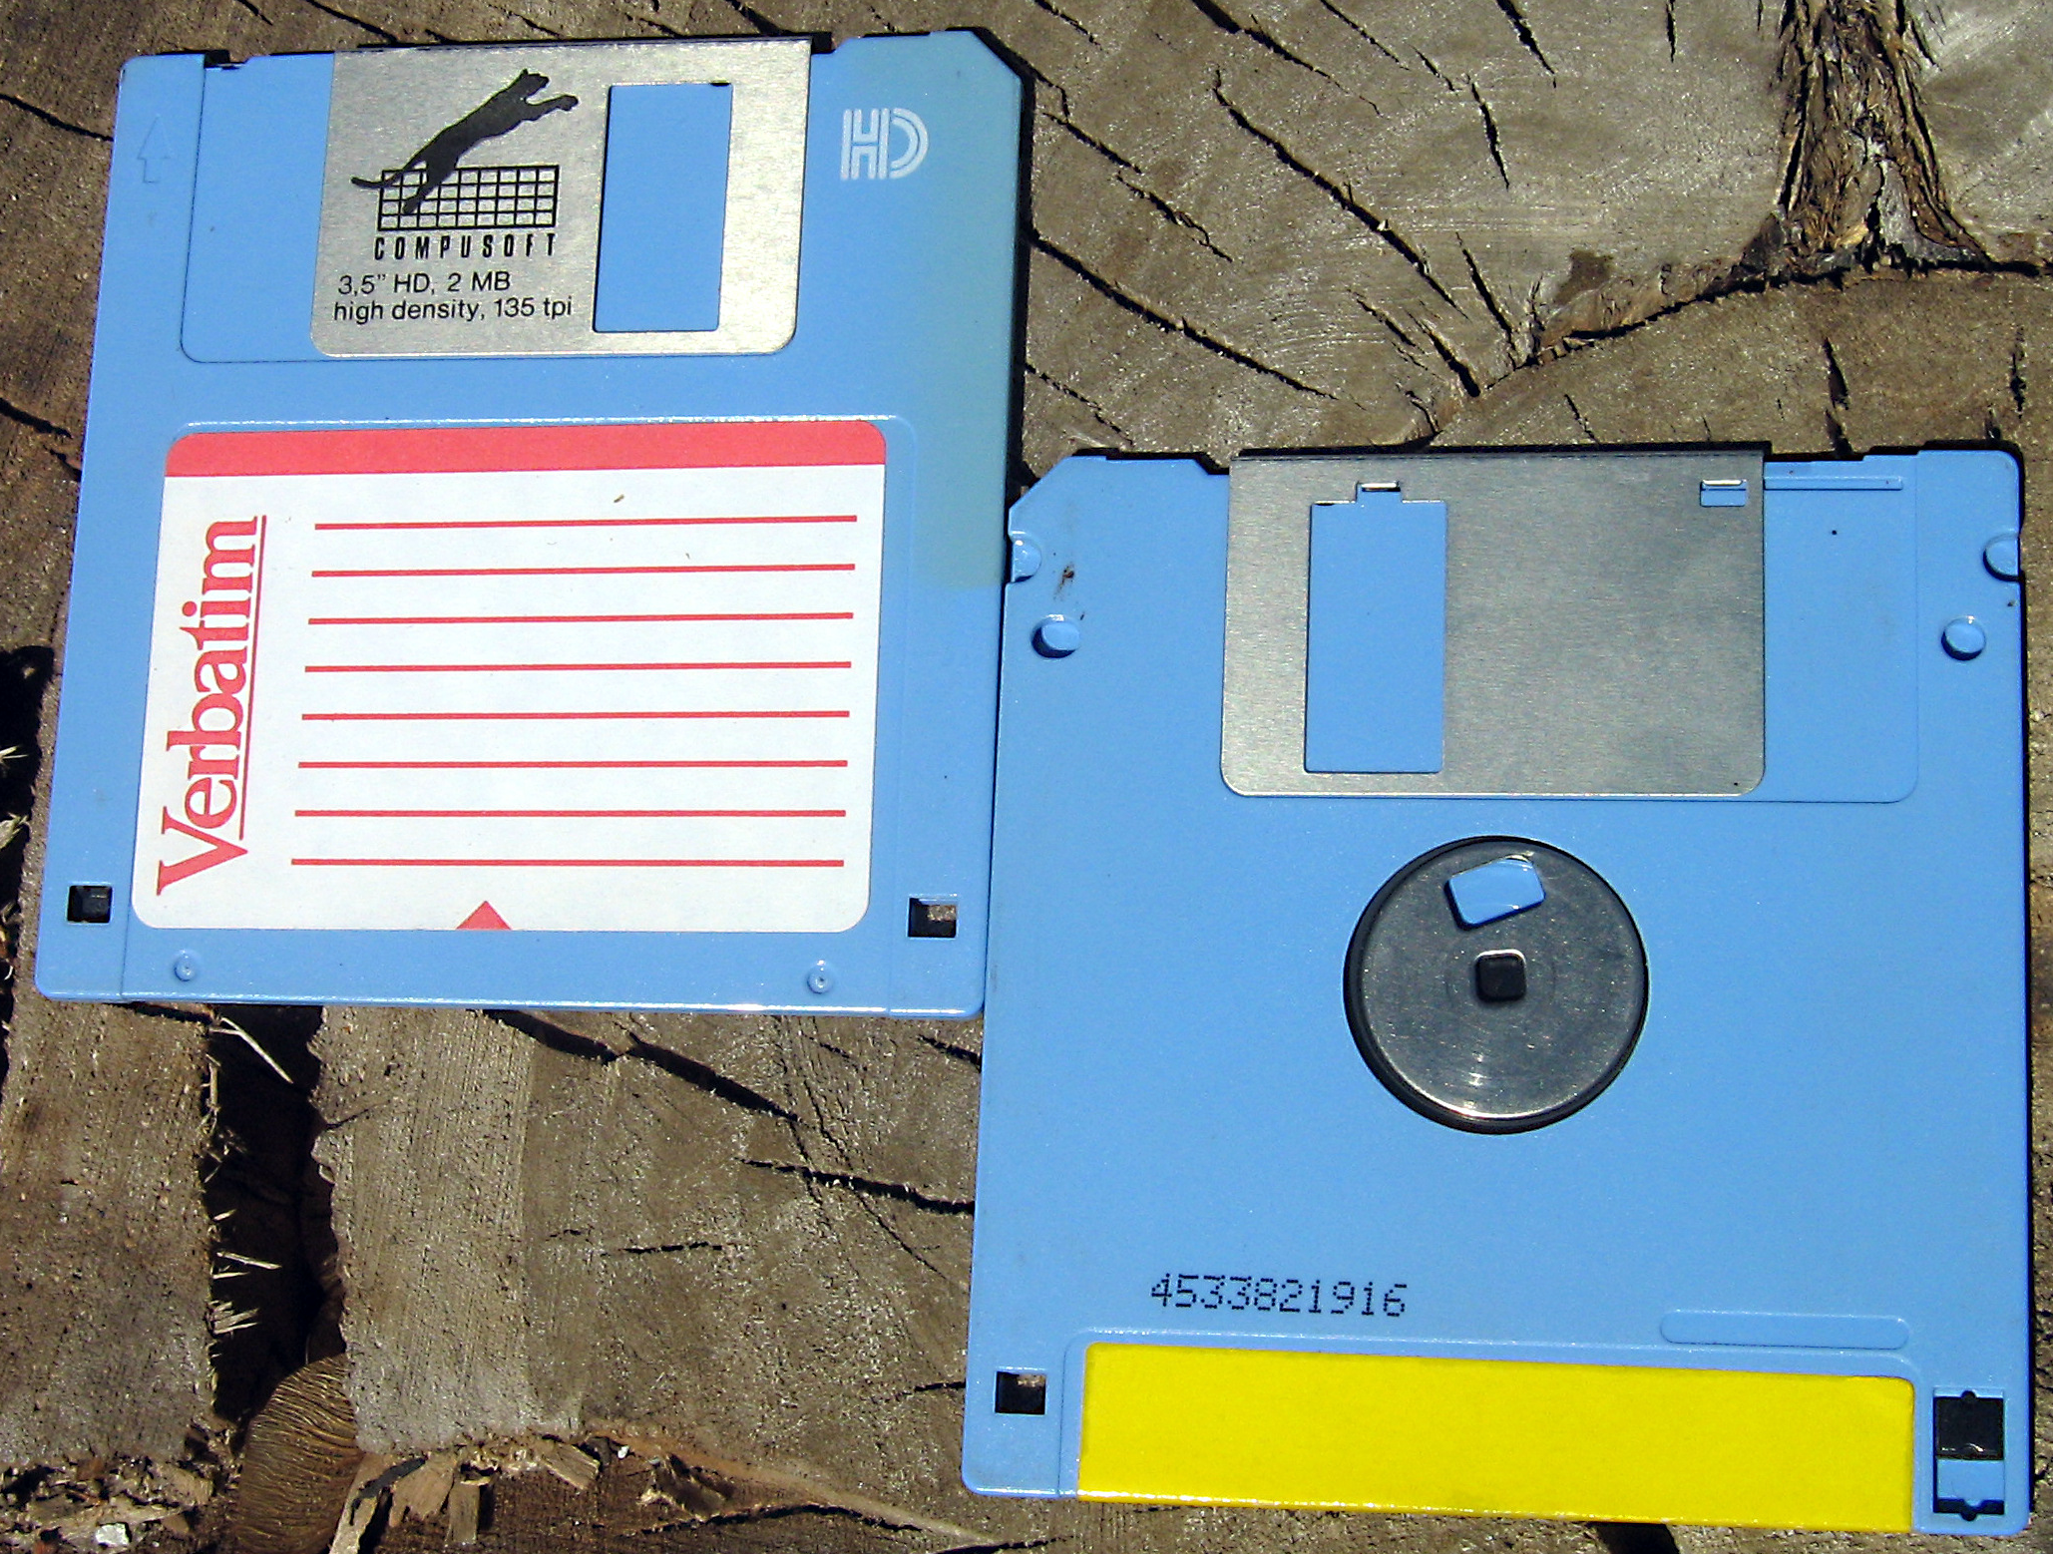
Today
Python and processing (big) data.
Python iterations and lists with Google Colab.
Python web server.
Bits -> Bytes -> .. -> Exabytes. How about putting these bytes somewhere?
Both images from Wikipedia.
Where is data? 1st idea: in files.
What is a file?

Slide 3
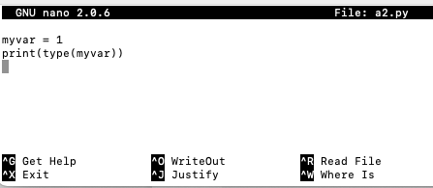
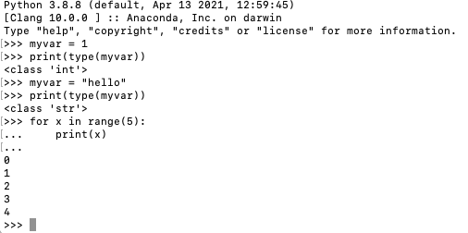
From last week
Assignment feedback
Creating a file on a Mac (many other ways, too): nano a2.py
Then python3 a2.py
<class 'int'>
+ Using Google Colab (later today)

Slide 4
This week’s main topics
Some nice well-known algorithms (sorting).
This means: Our first data structure is an array (or a list in Python's terminology).
The Big O notation https://runestone.academy/ns/books/published/pythonds/AlgorithmAnalysis/BigONotation.html
Python and data.
Python and files.
“A Python database program” (1980’s style).

Slide 5
Files
How big are files? What/where are they?
A text file Alice in Wonderland https://www.gutenberg.org/cache/epub/11/pg11.txt
A binary file, a photo of Chula, resolution 512x512.
https://lh3.googleusercontent.com/p/AF1QipPyWgLD6IyWQjkS-HiPSC7AqJksNIv7obfEfESr
Photos taken with a mobile phone camera are typically about 2 MB.
An audio file, MP3, 3 minutes of audio about 5 MB.
A video file, MP4, 40 minutes of video w audio about 300 MB. A small example, no audio: http://natto.mooo.com/earth.mp4
Wikipedia's English language text content (no images/sound/etc) is about 130 GB.
With the media a few terabytes.
A big collection of films (like an internet provider may have) can be a petabyte.
Exabyte? Some science labs are getting close https://home.cern/science/computing/storage

Slide 6
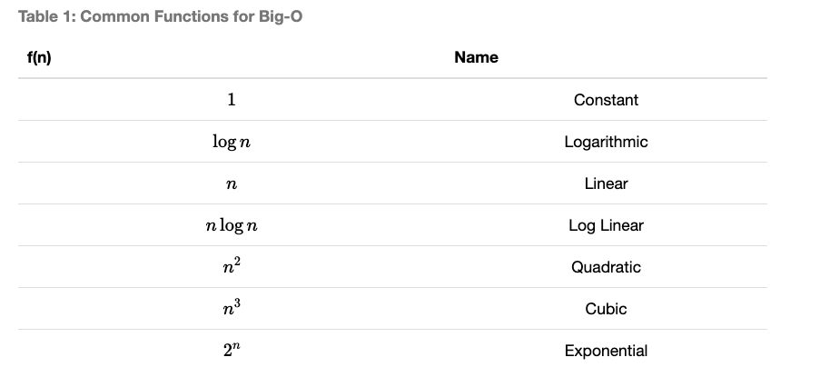
Big O (from the textbook) back at 10:00

Slide 7
Sorting
https://runestone.academy/ns/books/published/pythonds/SortSearch/TheSelectionSort.html
In the unsorted part of the array (originally the entire array) we look for the smallest element and put it in its place.. By swapping it with the element at that place.
Thus, the sorted part of the array grows .. until we have sorted the entire array.
Let's think of an array of 10 elements. Finding the largest will require a scan of the entire array (10 elements) first, after that 9 elements, after that 8 ..
10 + 9 + 8 + 7 + 6 + 5 + 4 + 3 + 2 comparisons (and potentially swaps, in the worst case).
http://liveexample.pearsoncmg.com/liang/animation/web/SelectionSort.html

Slide 8
Let's modify and measure
Instead of this small list alist = [54,26,93,17,77,31,44,55,20], modify the code so that the list contain 10 000 random integer elements. Measure and write down how long the execution took. Modify so that the list contains 20 000 random elements. Measure and write down the execution time. Similarly for 30 000 and 40 000.
You can measure the execution time by adding "%%time" on top of the cell on Google Colab.

Slide 9
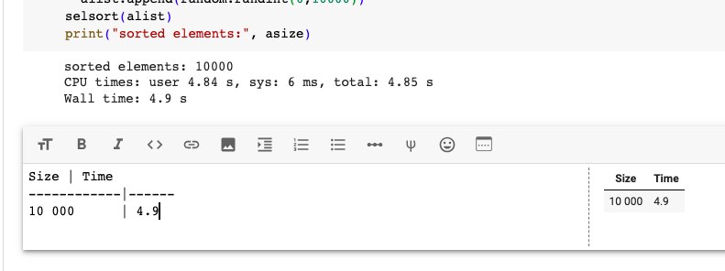
Let's modify and measure
It may look like this
Don't print the list! You'd be measuring the printing time, not sorting time.

Slide 10
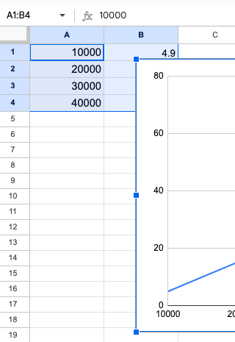
Let's modify and measure
Finally, let's make a Google Sheet and chart the data.

Slide 11
Performance..
Many businesses have hundreds of thousands of customers (or at least payment events) that could/should be sorted by any criteria. Selection sort is probably not the most suitable method.
Python's "own" method is a bit faster. But how can it be? How can there be sorting methods that are faster than selection sort?
Selection sort's time complexity is O(n²). Merge sort O(n * log n).
For details: https://www.youtube.com/watch?v=rL8X2mlNHPM (up to 7:10)

Slide 12
Example code, please run it on Google Colab
def selsort(mylist):
for i in range(0, len(mylist)):
minv = mylist[i]
minp = i
for l in range(i, len(mylist)):
if mylist[l] < minv:
minv = mylist[l]
minp = l
mylist[i], mylist[minp] = mylist[minp], mylist[i]
return(mylist)
alist = [54,26,93,17,77,31,44,55,20]
selsort(alist)

Slide 13
Next
Python Week 2 Lab.

Slide 14
Extra: How about searching?
You've started an online game studio and your game is a hit! Millions of people play many rounds every day .. but you want to get the users even more hooked.
You'd like to implement this kind of feature:
Only registered users can get their top scores in the hall of fame. The hall of fame has currently millions of scores in an ascending order. Many of them are "identical" (the same score). NB: Descending order..
For unregistered users who play your game you'd like to show a message like:
"If you had registered your score would be in position 6000! Register!" How?
0 | 1 | .. | 6000 | 6001 | 6002 | .. | 100001 | 100002 | ...
80999 | 80900 |  | 10700 | 10655 | 10655 |  | 2000 | 2000

